Slide 1
Microsoft Power BI

Slide 2
ALM in Power BI with Deployment Pipelines
Ted Pattison
Principal Program Manager
Power BI Customer Advisory Team (PBICAT)

Slide 3
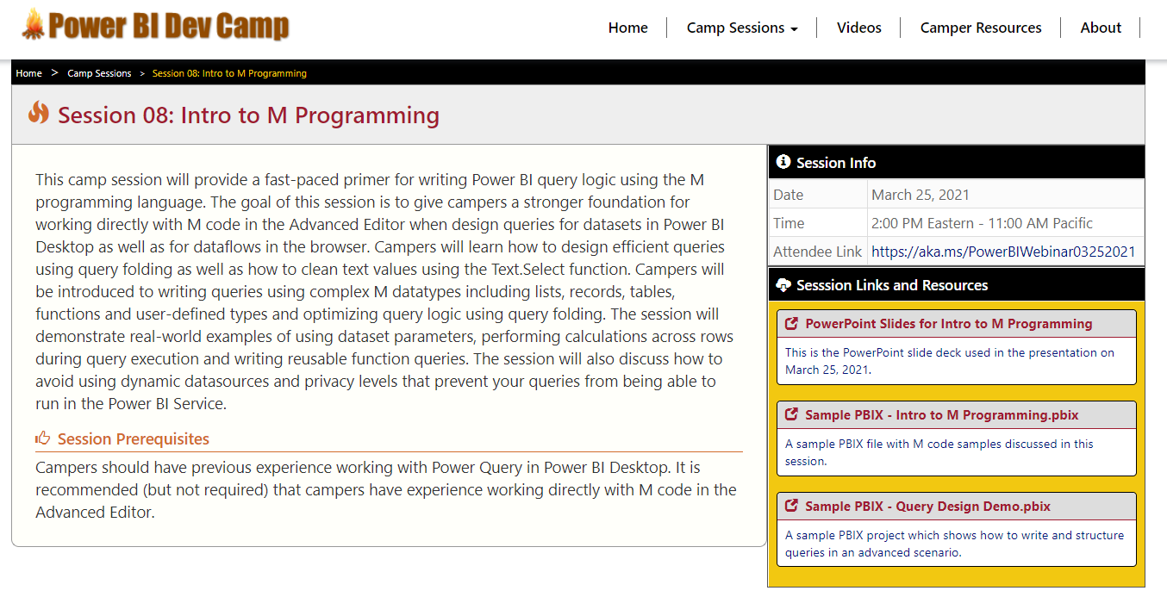
Welcome to Power BI Dev Camp
Power BI Dev Camp Portal - https://powerbidevcamp.net

Slide 4
Sample Code and Resource for This Session
https://github.com/PowerBiDevCamp/ALM-for-PowerBi

Slide 5
Agenda
Getting Started with Deployment Pipelines
Building and Versioning Power BI Artifacts
Publishing Artifacts to the Power BI Service
Creating and Configuring Deployment Rules
Using APIs to Create and Manage Deployment Pipelines
Deployment Pipelines Roadmap

Slide 6

What Are DevOps and CI/CD ?
What is DevOps?
Set of practices that integrate software development (Dev) together with IT operations (Ops)
Strategy to shorten the life cycle for delivering updates while maintaining high quality
Based on Agile development which promotes pushing updates in small incremental changes
What is Continuous Integration (CI)?
Strategy to integrate source code and deployment artifacts into shared repository with version control
What is Continuous Delivery (CD)?
Strategy to deploy new features, upgrades & bug fixes into production as soon as possible
Shared Repository
with version control
Automated Build/Test
with Azure DevOps
Operations
Production
Environment
Dev 1
Application Code v2
Build
Process
Application Code v1
CI
Application
CD
Application
Dev 2
Library Code v3
Library Code v2
Library Code v1

Slide 7
Managing DevOps CI\CD in a Power BI Environment
Content authors publish artifacts to shared repository with version control
Artifacts are deployed to Power BI workspace using Power BI REST API operations
Requires choosing a source control system for Power BI artifact source files
GitHub, Azure DevOps, OneDrive, SharePoint, etc.
Shared Repository
with version control
Power BI Workspace
Dataset Creator
Power BI Dataset v4
import
Power BI Dataset
Power BI Dataset v3
Power BI Dataset v2
Power BI Dataset v1
Report Creator
Power BI Report v4
import
Power BI Report 1
Power BI Dataset v3
Power BI Dataset v2
Power BI Dataset v1
Report Creator
Power BI Report v3
import
Power BI Report 2
Power BI Dataset v2
Power BI Dataset v1

Slide 8
ALM in Power BI with Deployment Pipelines
ALM features based on CI/CD of Power BI artifacts
ALM = Application Artifact Lifecyle Management
Power BI artifacts include datasets, reports, dashboards and dataflows*
Pipeline contains three workspace stages for Dev, Test and Prod
Pipelines automates deployment of artifacts across stages
Power BI Deployment Pipeline
Source Control System
Dev Workspace
Test Workspace
Production Workspace
Power BI Artifact 1
Power BI Artifact 1
Power BI Artifact 1
Power BI Artifact 1
import
deploy
deploy
Power BI Artifact 2
Power BI Artifact 2
Power BI Artifact 2
Power BI Artifact 2
Power BI Artifact 3
Power BI Artifact 3
Power BI Artifact 3
Power BI Artifact 3

Slide 9
Understanding Deployment Pipeline Stages
Dev Stage Workspace
Import artifacts, create dashboards, test basic functionality
Test Stage Workspace
Share content with testers and reviewers
Run user experience tests and performance tests with larger volumes of data
Production Stage Workspace
Used to serve content to main user base
Power BI Deployment Pipeline
OneDrive SharePoint
Dev Workspace
Production Workspace
Test Workspace
Power BI Dataset
Power BI Dataset
Power BI Dataset
GitHub
import
deploy
deploy
Power BI Report
Power BI Report
Power BI Report
Azure DevOps
Power BI Dashboard
Power BI Dashboard
Power BI Dashboard

Slide 10
Configuring Deployment Pipeline Stages
Each stage has an associated workspace
Workspace membership/permissions can be configured independently for each stage
Datasets in each stages can connect to different datasources via Deployment Rules
Workspace for any stage can be published as a Power BI App for testing or production
Power BI Deployment Pipeline
Dev Workspace
Test Workspace
Production Workspace
Power BI Report 1
Power BI Report 1
Power BI Report 1
Power BI Report 2
deploy
Power BI Report 2
deploy
Power BI Report 2
Power BI Dataset
Power BI Dataset
Power BI Dataset
Dev DB
Test DB
Production DB

Slide 11
Demo Creating a Deployment Pipeline

Slide 12
Creating a Development Pipeline
New nav pane button for Deployment pipelines
Only for organization with Premium capacities (P SKU, PPU SKU or A SKU)
Deployment pipeline links & buttons will be hidden from end users

Slide 13
Assigning a Workspace to a Deployment Pipeline
The list of available workspaces include only the following:
New workspace experience where user is workspace admin
Workspace resides in a premium capacity (P, PPU or A SKU)
Workspace isn’t already assigned to another pipeline
Only one workspace can be assigned to a pipeline
The other two workspaces will be created during initial deployment

Slide 14
Deploying Content from Stage to Stage
Deploying to an empty stage
First deployment creates workspace and requires capacity permissions to succeed.
All content is cloned with the same connections between items (refresh still required)
Reports connected to external dataset will remain connected after deploy
Initial deployment can be pushed to next stage (forwards) or previous stage (backwards)
Deploying to a populated stage
Updated items will override the content of their counterparts.
‘Deploy to previous stage’ is not available
Dev Workspace
Test Workspace
Production Workspace
Power BI Artifact 1
Power BI Artifact 1
Power BI Artifact 1
Power BI Artifact 2
deploy
Power BI Artifact 2
deploy
Power BI Artifact 2
Power BI Artifact 3
Power BI Artifact 3
Power BI Artifact 3

Slide 15
What attributes are deployed?
Copy & override
No copy, no override
Copy with rules
Report visuals
Report pages
Dashboard tiles
Model metadata
Item relationships
RLS Role Definitions
Auto Aggregations
Inc Refresh Policy
Sensitivity labels * * unless they exist in target
Data
Artifact IDs and URLs
Workspace Permissions
Workspace settings
App content and settings
Refresh schedule
RLS role assignment
Inc Refresh Partition
Datasources
Parameters

Slide 16
Permission model
View pipeline
Share with others
Edit & delete pipeline
Pipeline Access
View workspace content
Compare stages
Deploy reports & dashboards
Update datasets
Workspace Member
Workspace Admin
Assign/remove workspace
Configure rules
Dataset owner

Slide 17
Configuring Pipeline and Workspace Permissions

Slide 18
Agenda
Getting Started with Deployment Pipelines
Building and Versioning Power BI Artifacts
Publishing Artifacts to the Power BI Service
Creating and Configuring Deployment Rules
Using APIs to Create and Manage Deployment Pipelines
Deployment Pipelines Roadmap

Slide 19
Source Code Definitions for Power BI Artifacts
You must learn how to build and upgrade artifact source files
Different types of Power BI artifact use different file formats
Icon | Artifact Type | File Formats | Supports Parameters
 | Dataset | PBIX or BIM | Yes
 | Report | PBIX | No
 | Paginated Report | RDL | No
 | Dataflow | JSON | Yes
 | Dashboard | N/A | No
Artifact Source Files

Slide 20
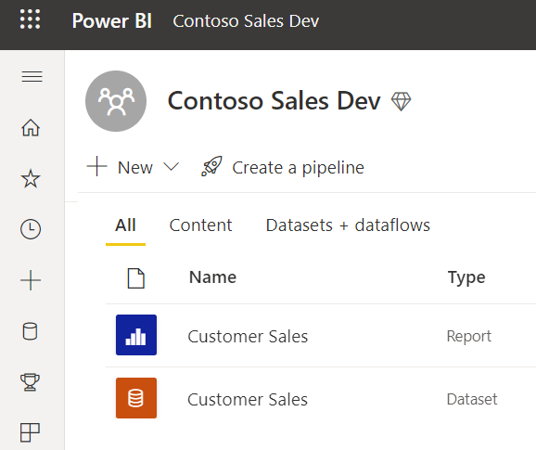
Building a Dataset and Report in Single PBIX File
Provides simplest and most-common approach
Single PBIX file does not allow multi-authoring
Updates for dataset and report can be separated
Single PBIX Scenario
Report Layout
Dataset Definition
Import
Customer Sales.pbix

Slide 21
Building Datasets & Reports in Separate PBIX Files
Dataset definition stored in separate PBIX file
Reports defined using satellite PBIX files with Live Connect to dataset
All PBIX files can be updated, versioned and updated independently
Might require rebinding report to dataset after import operation
Separate Dataset PBIX from Report PBIXs
Report Layout
(not used)
Report Layout
Dataset Definition
Product Sales Report.pbix
Product Sales Model.pbix
Report Layout
Top 10 Products.pbix

Slide 22
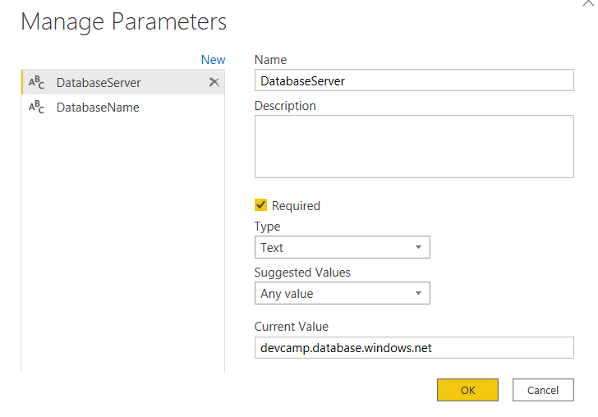
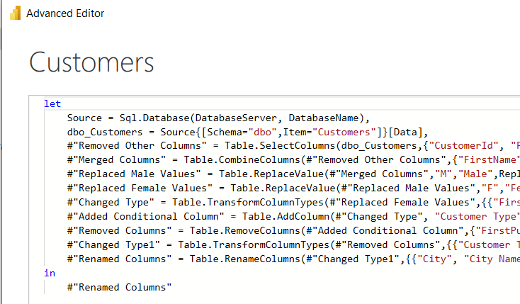
Designing Datasets with Parameters
What is a Dataset Parameter?
Configurable project-level setting for PBIX file
Strongly-typed value to which you can apply restrictions
Can be referenced from a query to determine datasource path
Dataset parameters can be updated in Power BI Service by hand or through API
Notes:
In the summer of 2016, the Power BI team added new support to Power BI Desktop so that you can create configurable parameters within the scope of a Power BI Desktop project. The two primary scenarios for creating project parameters is to parameterize data source settings and to parameterize filter criteria used in queries.

Slide 23


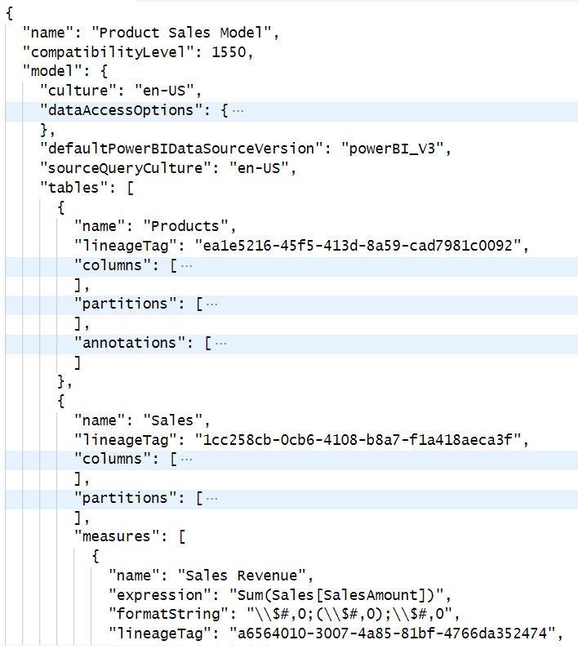
Developing Datasets using BIM Files
Dataset definitions can be maintained/developer using JSON-based BIM file format
Dataset definitions edited using external tools (e.g. Tabular Editor) or API (e.g. TOM)
Reports defined using satellite PBIX files with Live Connect to dataset
Requires rebinding report to dataset after import operation
Maintain Dataset Definition using BIM File Format
SSDT
Report Layout
Dataset Definition
Product Sales Report.pbix
Report Layout
Product Sales Model.bim
Top 10 Products.pbix

Slide 24
Viewing DIFFS Between BIM File Versions
You can track changes by looking a BIM file DIFFS in Azure DevOps Rep

Slide 25
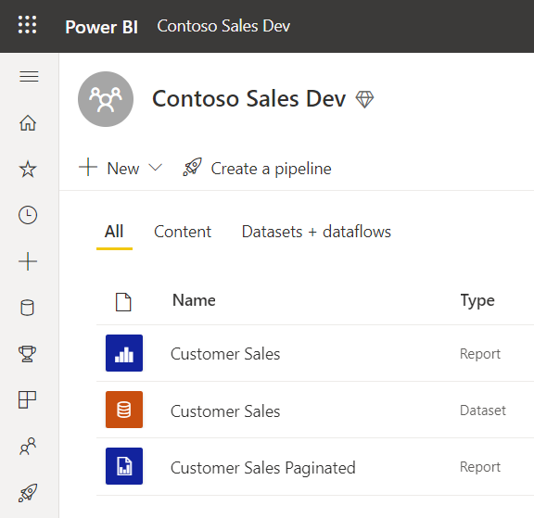
Building Paginated Reports
Paginated reports authored using Power BI Report Builder
Provides more control over printing/export process
Paginated report saved into XML-based RDL file

Slide 26
Deploy Dataflows
Dataflows can be created/edited in Power BI Service using browser
Dataflows can be exported/imported using JSON file format
Power BI Service API support importing JSON to create dataflow

Slide 27
Agenda
Getting Started with Deployment Pipelines
Building and Versioning Power BI Artifacts
Publishing Artifacts to the Power BI Service
Creating and Configuring Deployment Rules
Using APIs to Create and Manage Deployment Pipelines
Deployment Pipelines Roadmap

Slide 28
Using the Power BI REST API for ALM & Deployment
How to call the Power BI REST API?
Write PowerShell scripts using cmdlets from MicrosoftPowerBIMgmt
Call Power BI REST API directly by creating/managing HTTP requests
Use Power BI .NET SDK to increase productivity
Use Azure DevOps extension created for Power BI (e.g. Power BI Actions)
Power BI REST API operations used for ALM and DevOps
Create workspace
Assign workspace to a dedicated capacity
Import PBIX file
Update datasource parameters
Patch datasource credentials
Start dataset refresh operations
Create and bind gateway datasources

Slide 29
Learning to Write PowerShell Scripts for Power BI
Writing PowerShell Scripts for Power BI
Power BI Dev Camp Session from October 2020
Covers getting Started with cmdlet from MicrosoftPowerBIMgmt
Video: https://www.youtube.com/watch?v=WaKvZgjTWmo
Samples: https://github.com/PowerBiDevCamp/PowerBI-PowerShell-Tutorial/tree/master/Demos

Slide 30
Learning to Use the Power BI REST API
Advanced Data Set Programming with Power BI
Power BI Dev Camp Session from May 2021
Covers using Power BI REST API operations used in ALM
https://www.youtube.com/watch?v=rwVgbp0LdNs

Slide 31
Azure DevOps Extensions for Power BI
Power BI Actions by Maik van der Gaag
https://marketplace.visualstudio.com/items?itemName=maikvandergaag.maikvandergaag-power-bi-actions
Macaw Power BI Extensions
https://marketplace.visualstudio.com/items?itemName=Macaw.PowerBI-VSTS-Extensions

Slide 32
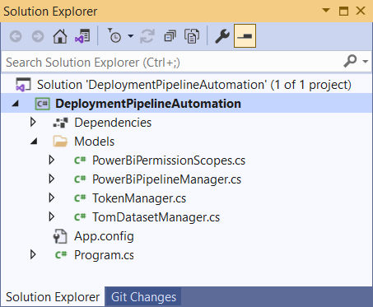
Developer Sample: DeploymentPipelineAutomation
Proof-of-Concept demo for managing ALM in Power BI using code
Written as simple C# application
Demonstrates how to deploy artifacts
Demonstrates how to program Deployment Pipelines

Slide 33
Agenda
Getting Started with Deployment Pipelines
Building and Versioning Power BI Artifacts
Publishing Artifacts to the Power BI Service
Creating and Configuring Deployment Rules
Using APIs to Create and Manage Deployment Pipelines
Deployment Pipelines Roadmap

Slide 34
Deployment Settings
Deployment settings allow you to create deployment rules
Click lightning icon button to display Deployment settings pane
Below are tabs for Dataflows, Datasets and Paginated Reports
Deployment settings

Slide 35
Adding Deployment Rules for Datasets
Dataset deployment rules allow for updates to connection string or parameters

Slide 36
Adding Deployment Rules for Paginated Reports
Paginated report deployment rules allow updates to connection string

Slide 37
Adding Deployment Rules for Dataflows
Dataflow deployment rules allow for updates to connection string or parameters

Slide 38
Deployment Rules Run During Deployment
You must process a deployment for rules to be set
You must refresh dataflows and import-mode datasets after deployment

Slide 39
Agenda
Getting Started with Deployment Pipelines
Building and Versioning Power BI Artifacts
Publishing Artifacts to the Power BI Service
Creating and Configuring Deployment Rules
Using APIs to Create and Manage Deployment Pipelines
Deployment Pipelines Roadmap

Slide 40
Deployment pipelines automation
Getting access to deployment pipeline object
Creating a new deployment pipeline

Slide 41
Processing Deploy Operations using DeployAll

Slide 42
First Time Deploy using PowerShell

Slide 43
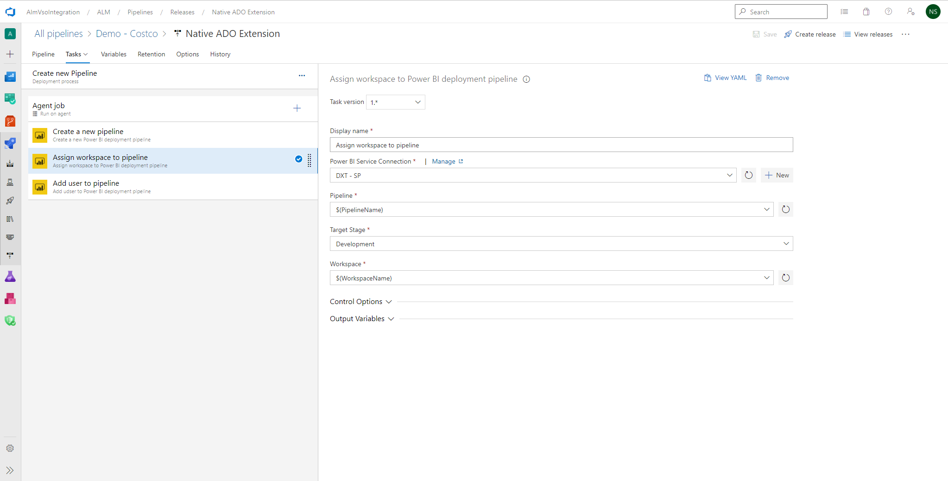
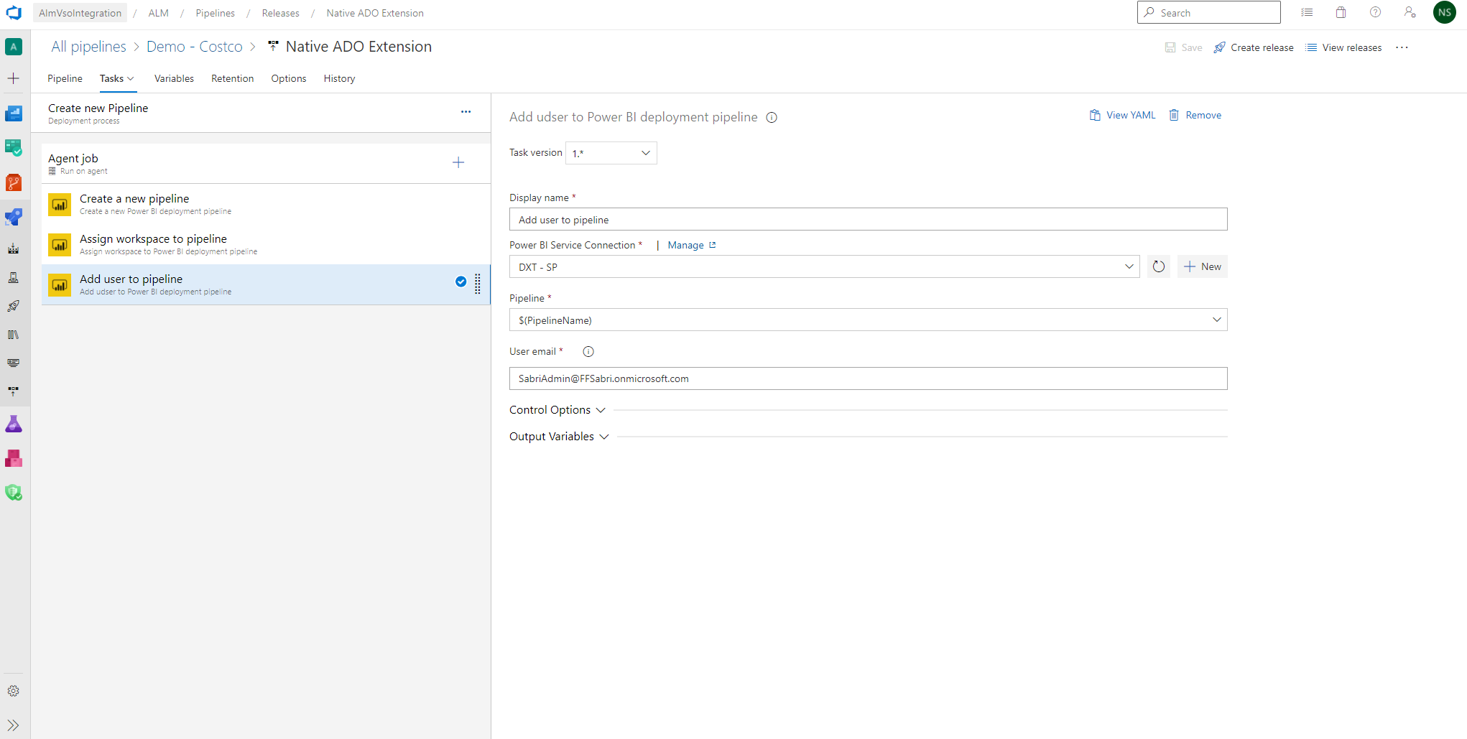
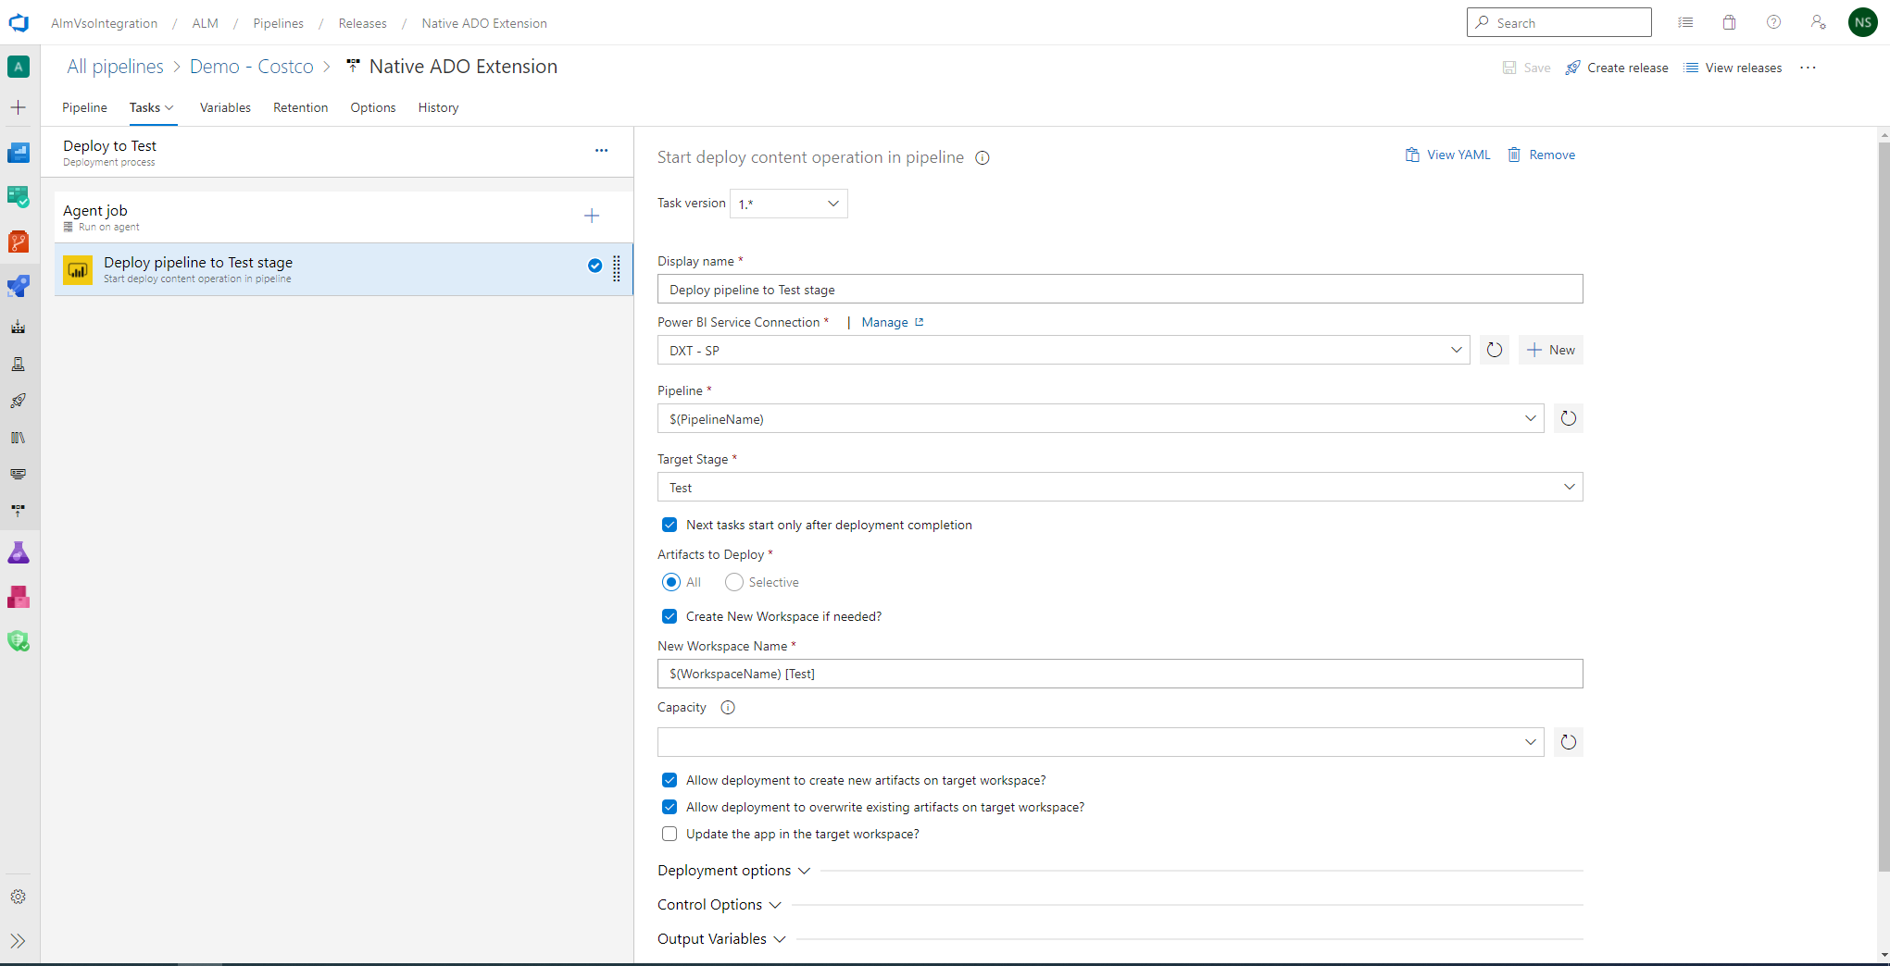
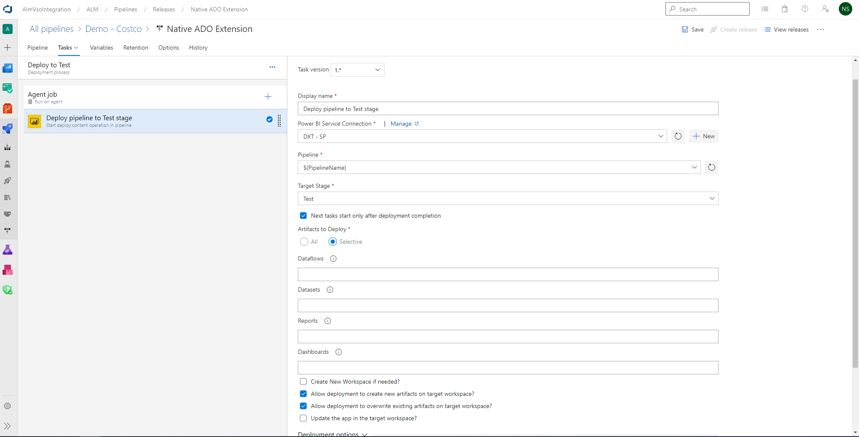
Coming Soon for Azure DevOps - Native ADO Extension

Slide 44
Agenda
Getting Started with Deployment Pipelines
Building and Versioning Power BI Artifacts
Publishing Artifacts to the Power BI Service
Creating and Configuring Deployment Rules
Using APIs to Create and Manage Deployment Pipelines
Deployment Pipelines Roadmap

Slide 45
Deployment Pipelines Roadmap
ADO native extension for pipelines APIs
Shown earlier in this presentation
Deployment pipeline support for Dataflows goes GA (Jan 2022)
Will include support for linked entities & multi-authoring of dataflows
Deployment history
Better summarization and auditing of deployment processing runs
Provides audit log of deployment history for all pipelines
Multiple pipelines working together
Split datasets and reports into separate pipelines

Slide 46
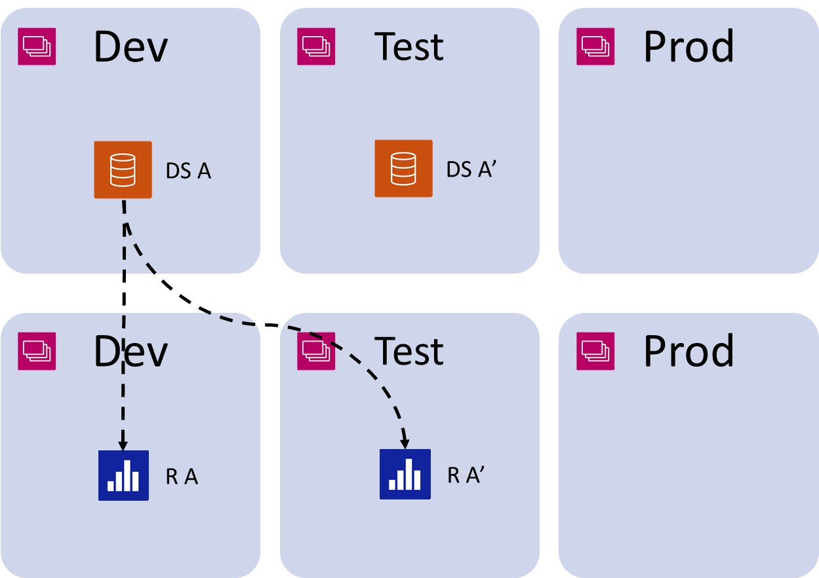
Multiple pipelines today
There is no coordination across pipelines
You cannot separate datasets and reports into separate pipelines/workspaces

Slide 47
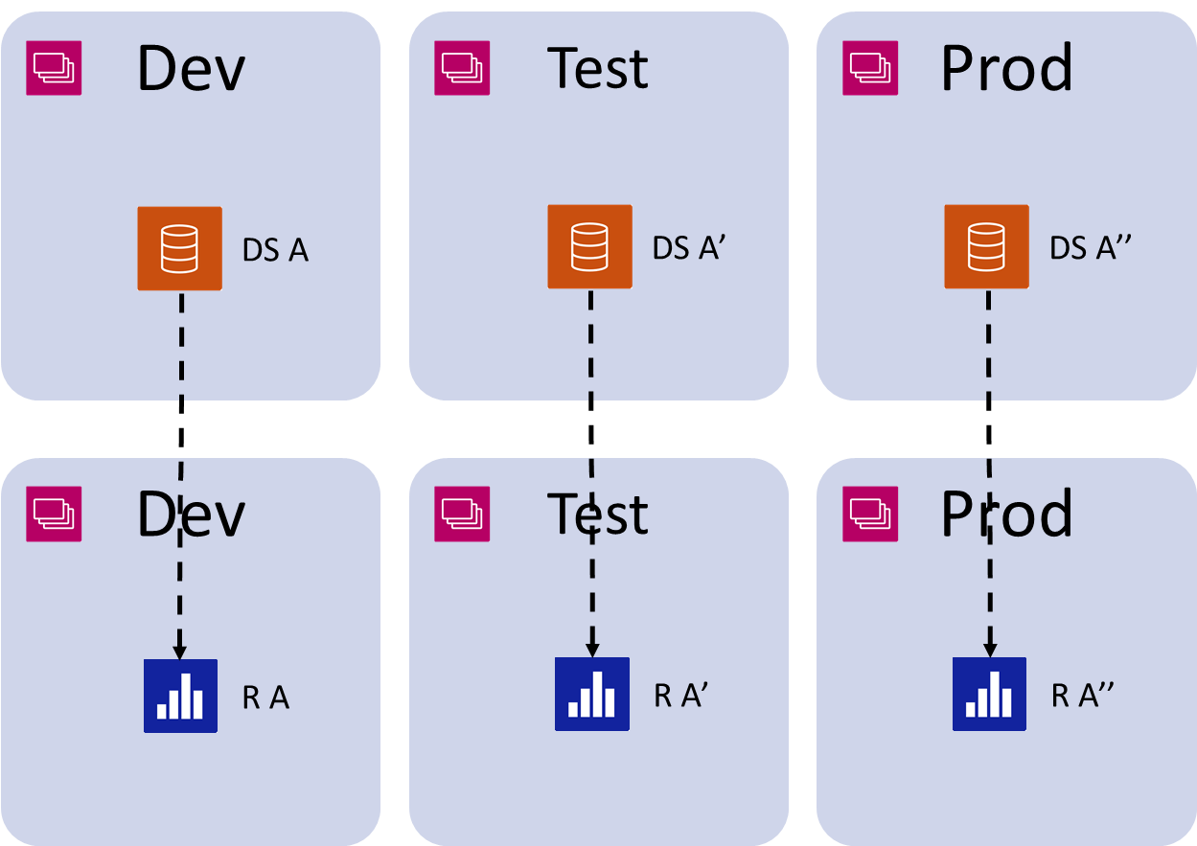
Multiple pipelines working together

Slide 48
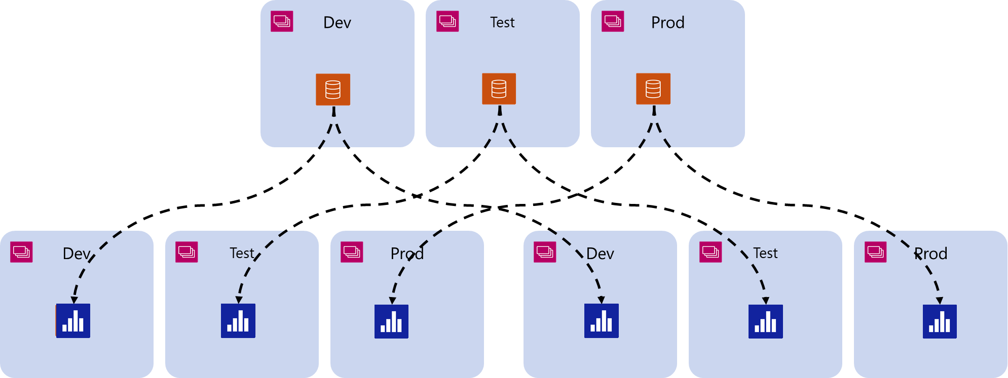
Multiple pipelines connection
Multiple pipelines working together

Slide 49
Summary
Getting Started with Deployment Pipelines
Building and Versioning Power BI Artifacts
Publishing Artifacts to the Power BI Service
Creating and Configuring Deployment Rules
Using APIs to Create and Manage Deployment Pipelines
Deployment Pipelines Roadmap

Slide 50
Microsoft Power BI
Questions?

